Slide 1


Housing Prices in London and the UK
Ean Pfeiffer, David Rodriguez-Jenkins, Brock Saxen
Data Acquisition and Analytics
School of Technology & Computing (STC)

Slide 2
Agenda
(Example) Problem Statement
Motivation
Background
Related Work
Approach
…
Conclusion
Future Work
Key Reference
Q&A

Slide 3
Problem Statement
We would like to explore housing prices in London and other major cities, as well as the UK as a whole and see how they compare.

Slide 4
Approach
With techniques we learned in this class we cleaned our datasets, then created dataframes, plots and heatmaps to show trends and findings in our data.

Slide 5

Technologies
Pandas
NumPy
Matplotlib.pyplot

Slide 6
Pandas
Pandas is a fast, powerful, flexible and easy to use data analysis tool that works with Python.

Slide 7
Numpy
NumPy is a tool used to perform a wide variety of mathematical operations and calculations and works with Python.

Slide 8
Matplotlib.pyplot
Matplotlib.pyplot is great for creating plots and visualizing data. It works well with Pandas and NumPy.

Slide 9
Data Cleaning
We had to do some data cleaning to come up with data that was more directly comparable and to remove values that would skew our visualizations, such as NaN and duplicate values.

Slide 10
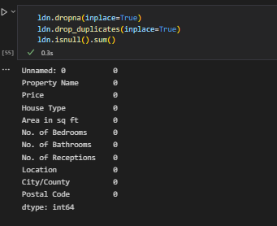
Data Cleaning
We used dropna(), drop duplicates(), and isnull() to help clean the data.

Slide 11
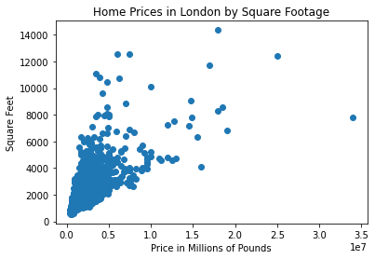
Findings
As we expected, home prices go up in proportion to square footage as well as with proximity to large cities. The average home price in London is £1.864.172, while the average home price in the UK is £328.828

Slide 12
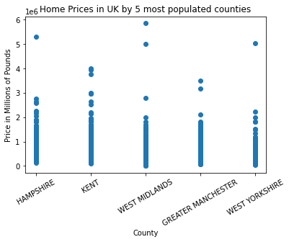
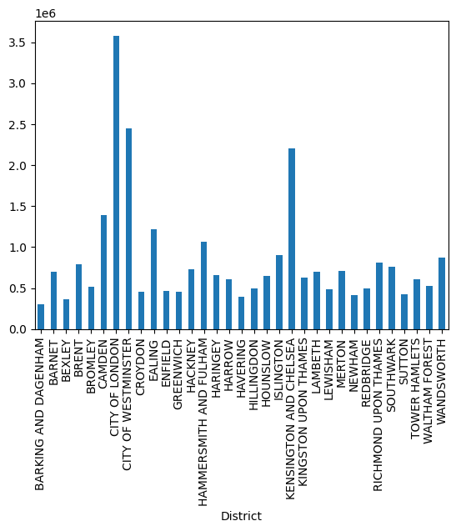
Findings contd.

Slide 13
Conclusion
Homes in metropolitan areas are much more expensive than the country as a whole, and there are a wide range of prices.

Slide 14
References
https://www.kaggle.com/datasets/hm-land-registry/uk-housing-prices-paid
https://www.kaggle.com/datasets/arnavkulkarni/housing-prices-in-london

Slide 15


Q&A

